Slide 1
Leveraging Predictive Analytics to Revolutionize Inventory Management in Online Retail
Author: Prashant Chikhalia
Affiliation: Pace University
Email: pc84184n@pace.edu
GitHub: https://github.com/chikhaliap10/CS668.git

Slide 2
Introduction
The primary problem is optimizing inventory and enhancing sales forecasting.
Current challenges include demand prediction, which leads to stockouts or overstock.
Goal: Develop a predictive model for inventory planning.

Slide 3
Research Questions
What factors influence online retail purchasing behavior?
Can historical data predict future sales trends?
How do seasonal patterns affect sales?
What strategies reduce overstock and prevent stockouts?

Slide 4
Literature Review
Key Findings & Insights
Time-Series Demand Forecasting with Ensemble Deep Learning:
Models significantly enhance prediction accuracy for inventory optimization but demand high computational resources (Seyedan et al., 2023).
Deep Q-Learning for Stock Balance:
Effective for adjusting stock policies, although data-intensive (Kayali & Turgay, 2023).
ES-C-T Model for Intermittent Retail Demand:
Outperforms traditional methods, yet struggles with volatility in demand (Erjiang et al., 2024).
Hybrid Models for E-commerce Product Management:
Integrating genetic algorithms with forecasting enhances accuracy, especially in B2C e-commerce environments (Yüregir et al., 2024).
Application to Current Work
Positioning: Focus on combining ensemble approaches and hybrid models for robust demand forecasting.
Identified Needs: Efficient data processing solutions to handle high computational demands in real-time forecasting.

Slide 5
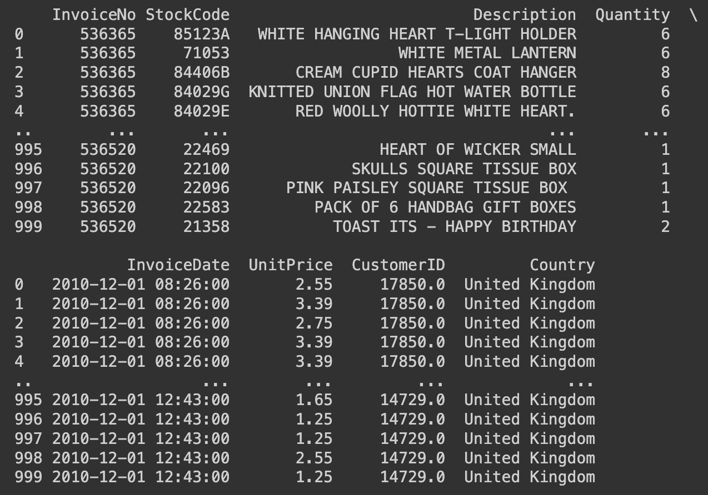
Dataset
Link to the Data: https://archive.ics.uci.edu/dataset/352/online+retail
Description: This dataset contains historical sales data from an online retail business operating in the United Kingdom. The data spans transactions recorded from December 1, 2010.
Size: Approximately 540,000 rows (depending on the full dataset structure).
Parameters:
InvoiceNo: Unique identifier for each transaction.
StockCode: Product code.
Description: Details of the product sold.
Quantity: Number of items sold.
InvoiceDate: Date and time of the transaction.
UnitPrice: Price per unit.
CustomerID: Unique identifier for the customer.
Country: Country where the customer resides.

Slide 6
EDA & Methodology
Preliminary EDA Findings:
Dataset Summary: Conducted an initial review of the dataset, focusing on important features like InvoiceNo, StockCode, Quantity, UnitPrice, and InvoiceDate.
Handling Missing Data: Found and addressed missing entries in CustomerID and Description columns.
Duplicates Removal: Removed duplicate entries to enhance data accuracy and consistency.
Distribution Patterns:
Quantity, Unit Price, and Revenue: Observed that these variables are right-skewed. Most transactions involve smaller quantities, lower prices, and modest revenue, with a few large outliers.
Country Insights: Noted that the United Kingdom accounts for the majority of transactions, while other countries have lower but notable contributions.

Slide 7
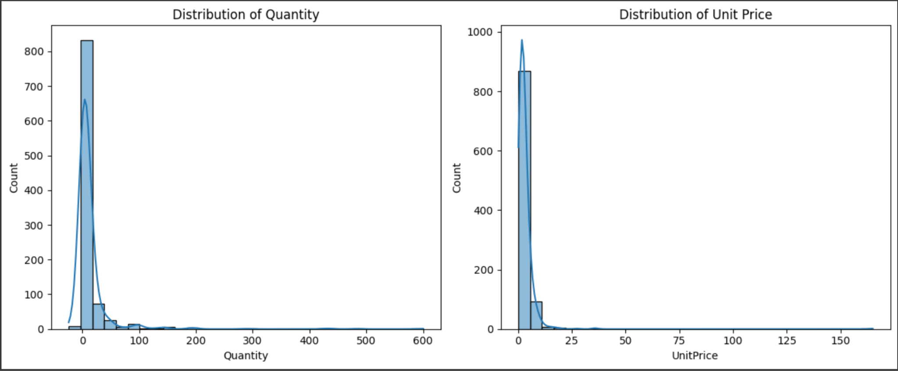
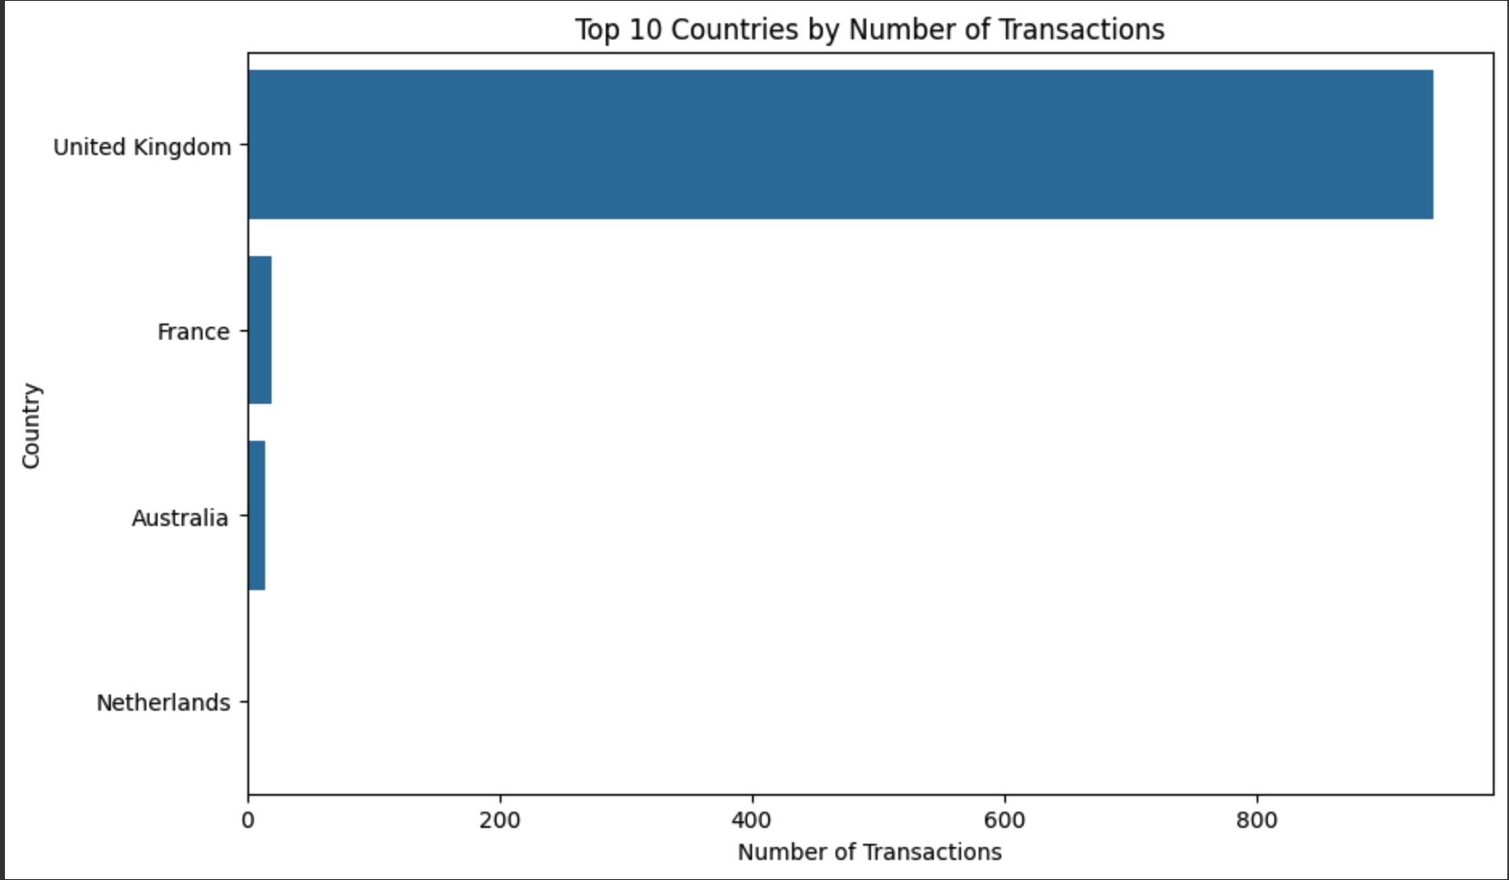
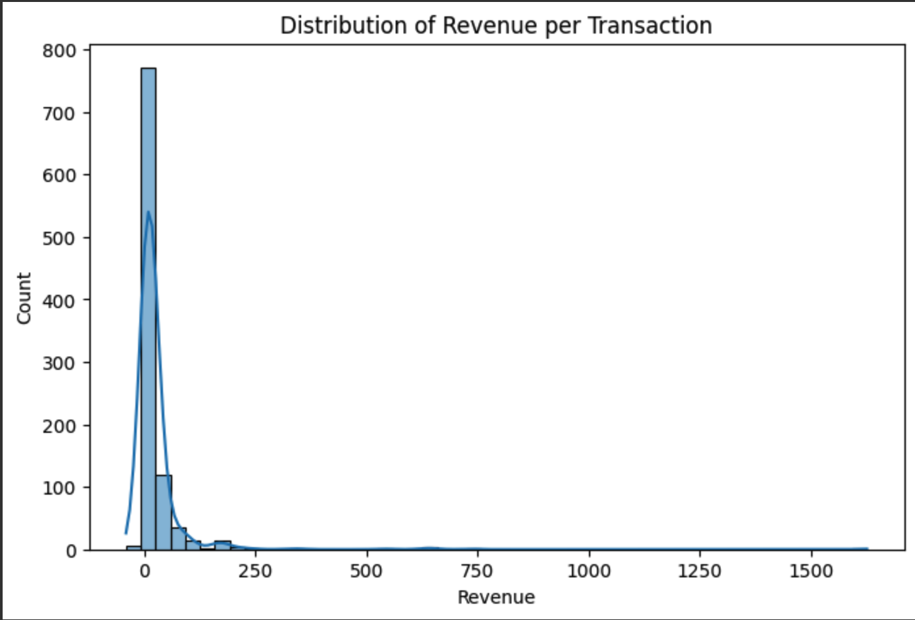
EDA & Methodology
Distribution of Quantity and Unit Price in Transactions
Top 10 Countries by Number of Transactions
Distribution of Revenue per Transaction

Slide 8
Next Steps
Perform Advanced Exploratory Data Analysis
Examine trends over time (e.g., monthly/weekly revenue, peak purchase times).
Segment customers based on purchasing behavior to identify patterns.
Feature Engineering
Create new features like customer lifetime value, average order size, and purchase frequency.
Generate time-based features from transaction dates, like day_of_week or month.
Handle Outliers and Normalize Data
Identify and handle any outliers in Quantity and UnitPrice.
Normalize numerical data if required for model accuracy.
Modeling and Predictions
Implement clustering for customer segmentation.
Apply time series analysis for forecasting future sales trends.
Evaluate Model Performance
Use metrics to assess model effectiveness and adjust as needed.
Interpret results to draw actionable insights.
Visualization and Insights
Develop visualizations that communicate findings effectively.
Prepare final insights and recommendations for stakeholders.
Document Findings and Recommendations
Summarize key insights in a project report.
Provide actionable recommendations for future business strategy.

Slide 9
References
Erjiang, E., Tian, X., Tao, Y., & Sun, H. (2024). An ES-based model with contemporaneous and temporal aggregation for forecasting intermittent and lumpy retail demand. Procedia Computer Science. https://doi.org/10.1016/j.procs.2024.03.002
Jeong, B., Jung, H., & Park, N. (2002). A computerized causal forecasting system using genetic algorithms in supply chain management. Journal of Systems and Software, 64(8), 345–355. https://doi.org/10.1016/S0164-1212(01)00157-8
Kayali, S., & Turgay, S. (2023). Predictive analytics for stock and demand balance using deep Q-learning algorithm. International Journal of Production Economics, 102912. https://doi.org/10.1016/j.ijpe.2023.102912
Praveenadevi, D., Sreekala, S.P., Krishna Teja, K.V.R., Girimurugan, B., Naga Kamal, G., & Chandra, A.C. (2023). An enhanced method on using deep learning techniques in supply chain management. IEEE Xplore. https://ieeexplore.ieee.org/document/10151338
Seyedan, M., Mafakheri, F., & Wang, C. (2023). Order-up-to-level inventory optimization model using time-series demand forecasting with ensemble deep learning. Journal of Forecasting, 45(3), 271-283. https://www.sciencedirect.com/science/article/pii/S2772818623000200
Yüregir, H.O., Özşahin, M., & Yetğin, S.A. (2024). A new hybrid approach for product management in e-commerce. Applied Sciences, 14(13), 5735. https://www.mdpi.com/2076-3417/14/13/5735
Zhao, L., Ding, D., Zou, P., Gong, Y., Chen, X., Zhang, J., Gao, J., Wu, Y., & Duan, Y. (2020). Distant supervision for e-commerce query segmentation via attention network. arXiv. https://arxiv.org/abs/2011.04166

